Slide 1
Hypothesis Testing

Slide 2
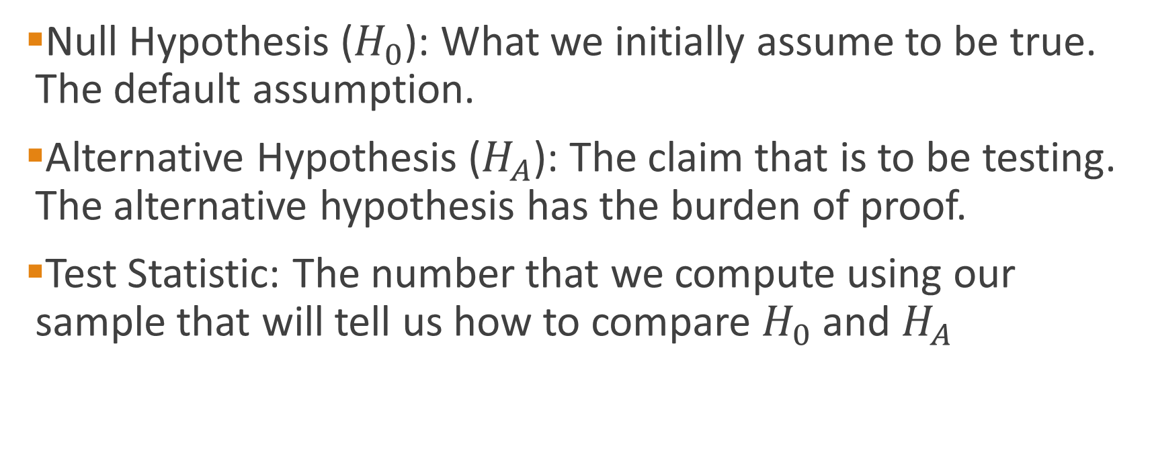
Hypothesis Testing
Null Hypothesis ($H_{0}$): What we initially assume to be true. The default assumption.
Alternative Hypothesis ($H_{A}$): The claim that is to be testing. The alternative hypothesis has the burden of proof.
Test Statistic: The number that we compute using our sample that will tell us how to compare $H_{0}$ and $H_{A}$

Slide 3
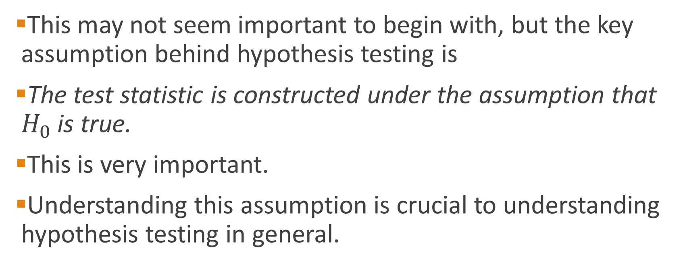
Hypothesis Testing
This may not seem important to begin with, but the key assumption behind hypothesis testing is
The test statistic is constructed under the assumption that $H_{0}$ is true.
This is very important.
Understanding this assumption is crucial to understanding hypothesis testing in general.

Slide 4
A. Rejection Region Method:
Divide the distribution into rejection and non-rejection regions
Defines the unlikely values of the sample statistic if the null hypothesis is true, the critical value(s)
Defines rejection region of the sampling distribution
Rejection region(s) is designated by α , (level of significance)
Typical values are .01, .05, or .10
α is selected by the researcher at the beginning
α provides the critical value(s) of the test

Slide 5
Rejection Region or Critical Value Approach:
Level of significance = α
Non-rejection region
Represents
critical value
a
H₀: μ = 12 H₁: μ ≠ 12
a
/2
/2
Two-tail test
0
H₀: μ ≤ 12 H₁: μ > 12
a
Rejection region is shaded
Upper-tail test
0
H₀: μ ≥ 12 H₁: μ < 12
a
Lower-tail test
0

Slide 6
P-Value Approach –
P-value=Max. Probability of (Type I Error), calculated from the sample.
Given the sample information what is the size of blue are?
H₀: μ = 12 H₁: μ ≠ 12
Two-tail test
0
H₀: μ ≤ 12 H₁: μ > 12
Upper-tail test
0
H₀: μ ≥ 12 H₁: μ < 12
0

Slide 7
P-Value approach to Hypothesis Testing:
The rejection region approach allows you to examine evidence but restrict you to not more than a certain probability (say α = 5%) of rejecting a true H₀ by mistake.
The P-value approach allows you to use the information from the sample and then calculate the maximum probability of rejecting a true H₀ by mistake.
Another way of looking at P-value is the probability of observing a sample information of “A=11.5” when the true population parameter is “12=B”. The P-value is the maximum probability of such mistake taking place.

Slide 8
That is to say that P-value is the smallest value of α for which H₀ can be rejected based on the sample information
Convert Sample Statistic (e.g., sample mean) to Test Statistic (e.g., Z statistic )
Obtain the p-value from a table or computer
Compare the p-value with α
If p-value < α , reject H₀
If p-value ≥ α , do not reject H₀

Slide 9
Test of Hypothesis for the Mean
σ known
σ Unknown
The test statistic is:
The test statistic is:

Slide 10
Steps to Hypothesis Testing
State the H₀ and H₁ clearly
Identify the test statistic (two-tail, one-tail, and Z or t distribution
Depending on the type of risk you are willing to take, specify the level of significance,
Find the decision rule, critical values, and rejection regions. If –CV<actual value (sample statistic) <+CV, then do not reject the H₀
Collect the data and do the calculation for the actual values of the test statistic from the sample

Slide 11
Steps to Hypothesis testing, continued
Make statistical decision
Do not Reject H₀
Reject H₀
Conclude H₀ may be true
Conclude H₁ is “true”
(There is sufficient evidence of H1)
Make management/business/administrative decision

Slide 12
When do we use a two-tail test? when do we use a one-tail test?
The answer depends on the question you are trying to answer.
A two-tail is used when the researcher has no idea which direction the study will go, interested in both direction. (example: testing a new technique, a new product, a new theory and we don’t know the direction)
A new machine is producing 12 fluid once can of soft drink. The quality control manager is concern with cans containing too much or too little. Then, the test is a two-tailed test. That is the two rejection regions in tails is most likely (higher probability) to provide evidence of H_{1.}
12

Slide 13
One-tail test is used when the researcher is interested in the direction.
Example: The soft-drink company puts a label on cans claiming they contain 12 oz. A consumer advocate desires to test this statement. She would assume that each can contains at least 12 oz and tries to find evidence to the contrary. That is, she examines the evidence for less than 12 0z.
What tail of the distribution is the most logical (higher probability) to find that evidence? The only way to reject the claim is to get evidence of less than 12 oz, left tail.
11.5
12
14

Slide 14
Example: Ages of MBA students
Historically MBA students in the United States have had an average age 30 years old.
It appears that this year MBA students are older that in past years.
A random sample of 100 students was taken and the average age was 32 with a sample standard deviation of 6 years.
Is there enough evidence to say that this years MBA students are older than in past years?

Slide 15
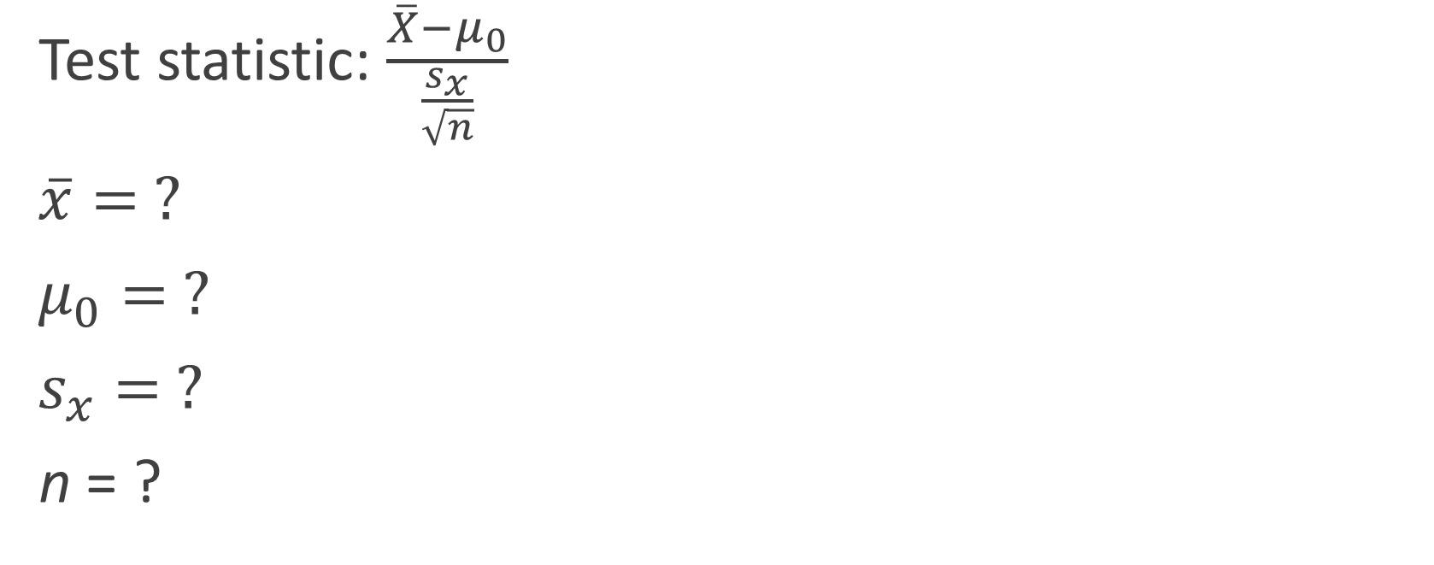
Example: MBA Ages
Test statistic: $\frac{\overline{X}−μ_{0}}{\frac{s_{x}}{\sqrt{n}}}$
$\overline{x}= ?$
$μ_{0}= ?$
$s_{x}= ?$
n = ?
Notes:
X bar = 32
Mu nought = 30
S x = 6
N = 100

Slide 16
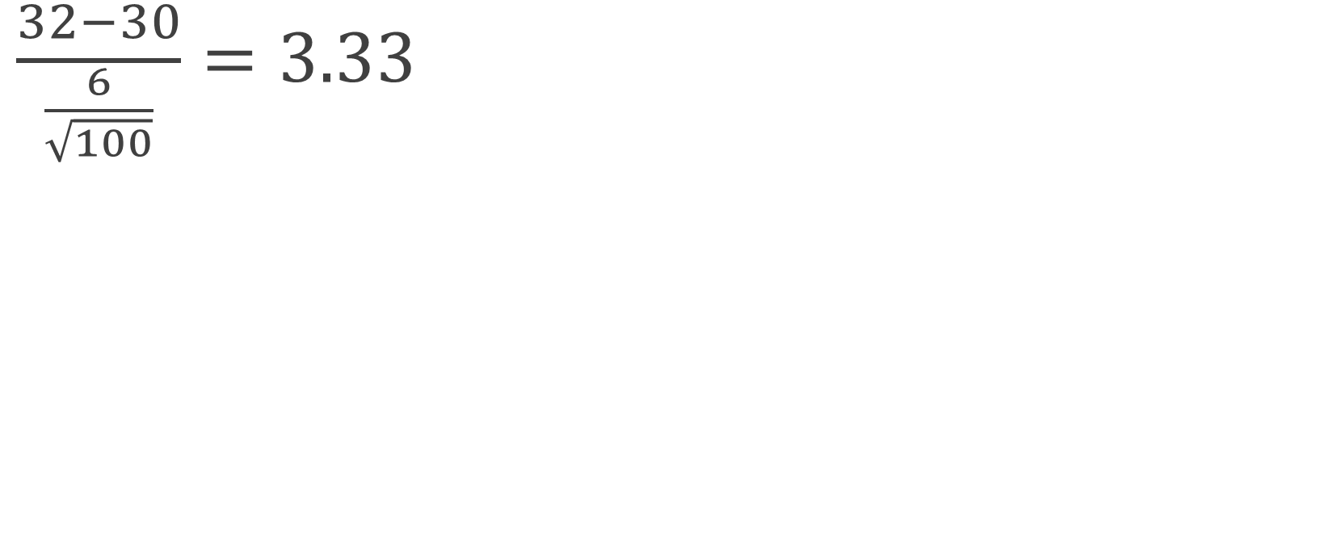
Example: MBA Ages
$\frac{32−30}{\frac{6}{\sqrt{100}}}=3.33$

Slide 17
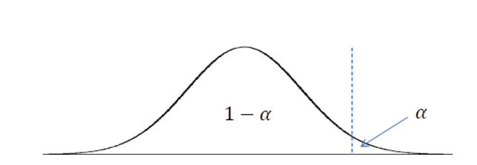
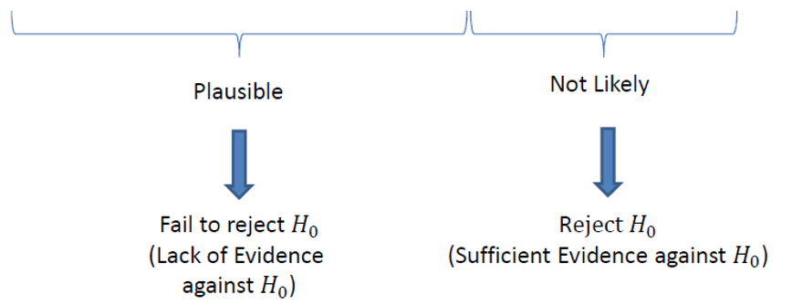

Slide 18
t (99) = 1.66

Slide 19

$$3.33$$
t (99) = 1.66

Slide 20
$$3.33$$
t (99) = 1.66

Slide 21
Example: Average Weight of a Loaf of Bread
Suppose you own a bakery and you hire a new baker because the old baker quit. The old baker was very good at making sure the loaves of bread were all very close to weighing 0.5 pounds. You suspect that the new baker is making the loaves too small.
To test this claim you take a sample of 81 loaves. The average weight of those loaves is 0.49 lbs. The standard deviation you will use is 0.06 lbs.
What is your conclusion?

Slide 22
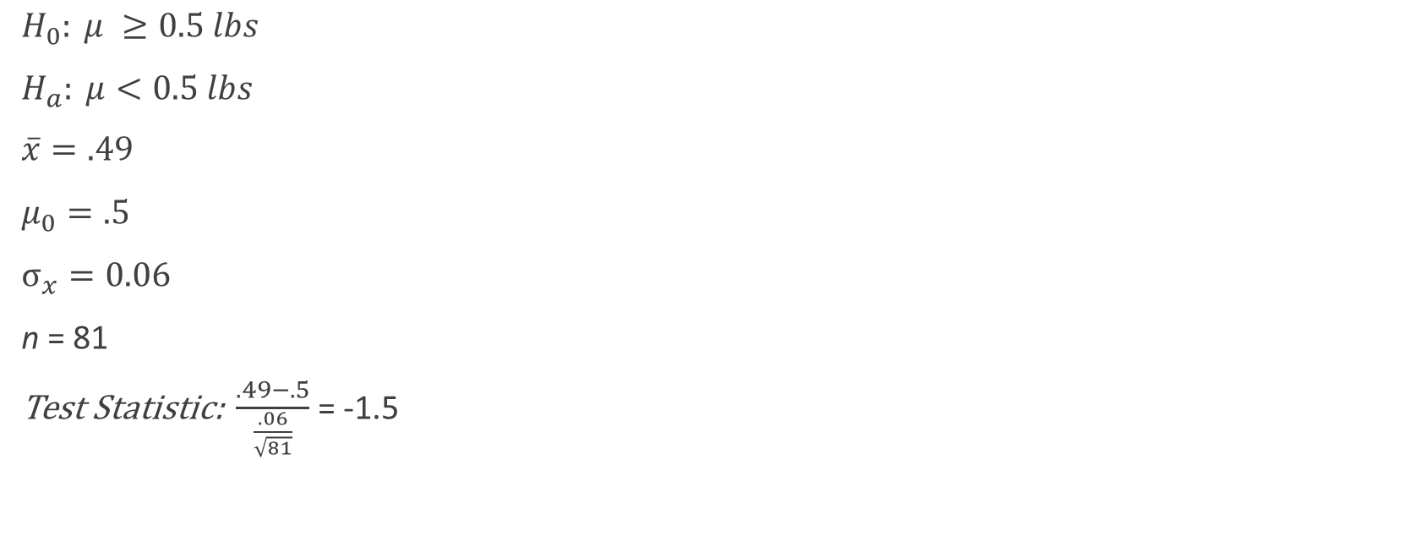
Example: Average Weight of a Loaf of Bread
$H_{0}: μ ≥0.5 lbs$
$H_{a}: μ<0.5 lbs$
$\overline{x}=.49$
$μ_{0}=.5$
$σ_{x}=0.06$
n = 81
Test Statistic: $\frac{.49−.5}{\frac{.06}{\sqrt{81}}}$ = -1.5

Slide 23
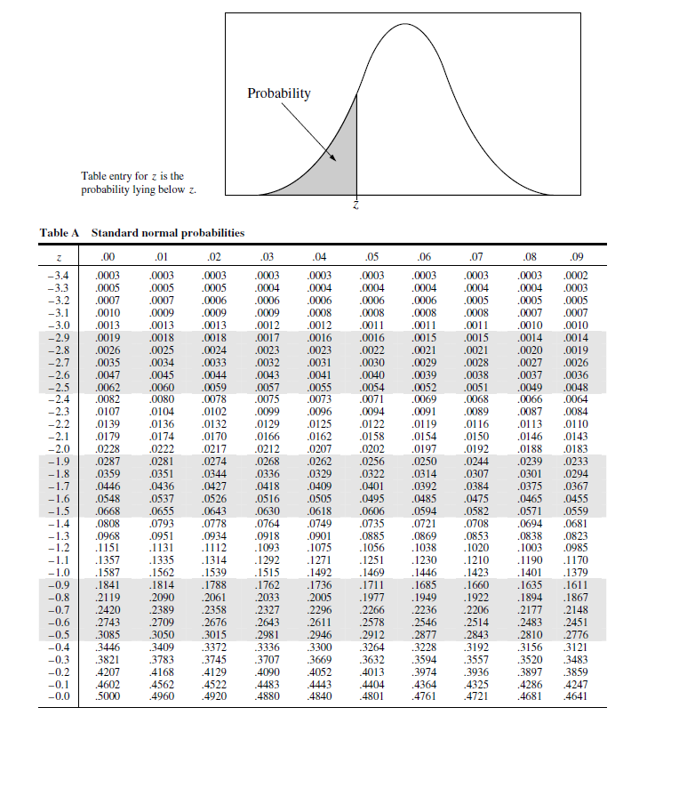
The p-value at a z score of -1.5 is .0668.
This corresponds with a result that H_{a} is almost significant or tending towards significance.

Slide 24
What the p-value is not
The p-value is not the probability that the null hypothesis is true.
The p-value is not the probability that a finding is "merely a fluke.“
The p-value is not the probability of falsely rejecting the null hypothesis.
The p-value is not the probability that a replicating experiment would not yield the same conclusion.

Slide 25
Type I and Type II errors

Slide 26
Type I and II Errors:
The size of α , the rejection region, affects the risk of making different types of incorrect decisions.
Type I Error
Rejecting a true null hypothesis when it should NOT be rejected
Considered a serious type of error
The probability of Type I Error is α
It is also called level of significance of the test
Type II Error
Fail to reject a false null hypothesis that should have been rejected
The probability of Type II Error is β

Slide 27
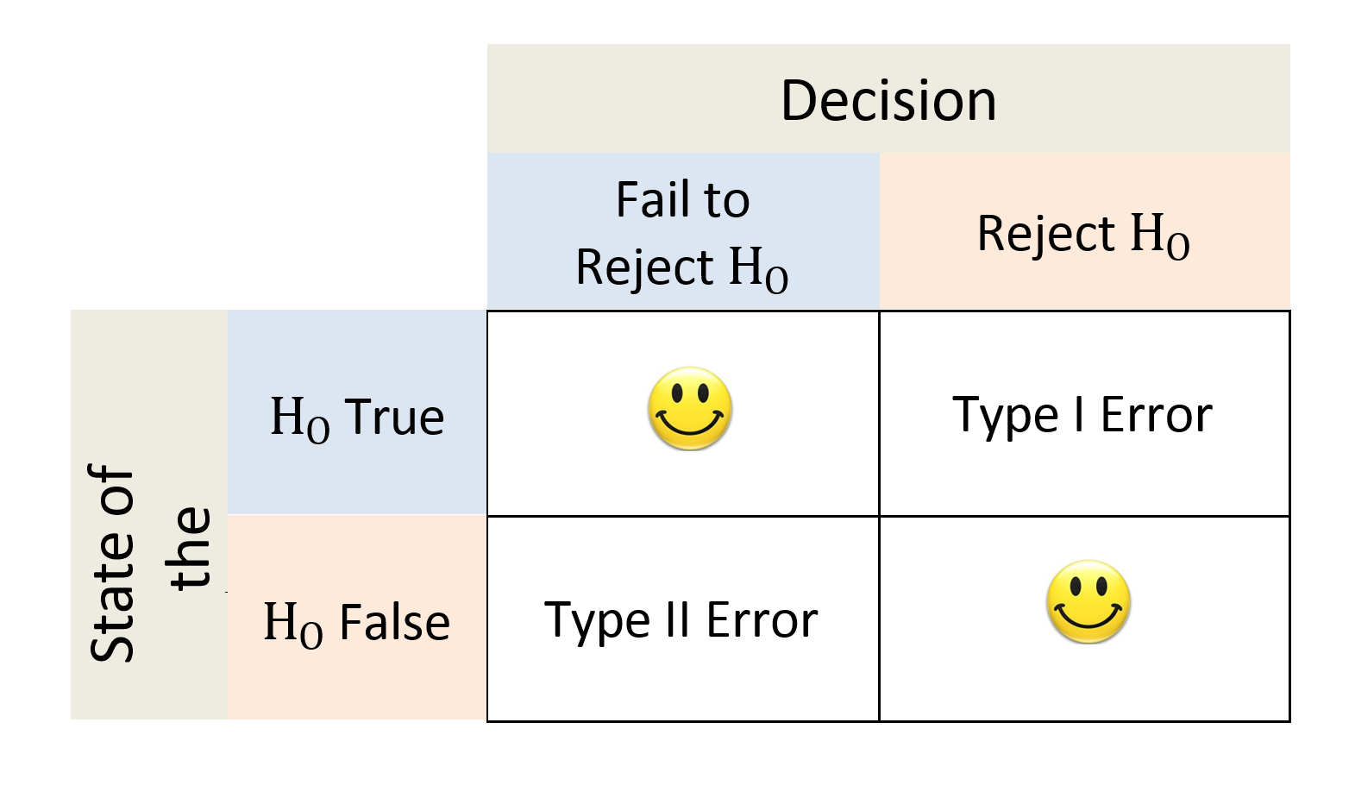

Slide 28
Type I and Type II errors cannot happen at the same time
Type I error can only occur if H₀ is true
Type II error can only occur if H₀ is false
There is a tradeoff between type I and II errors. If the probability of type I error ( α ) increased, then the probability of type II error ( β ) declines.
When the difference between the hypothesized parameter and the actual true value is small, the probability of type two error (the non-rejection region) is larger.
Increasing the sample size, n, for a given level of α, reduces β

Slide 29
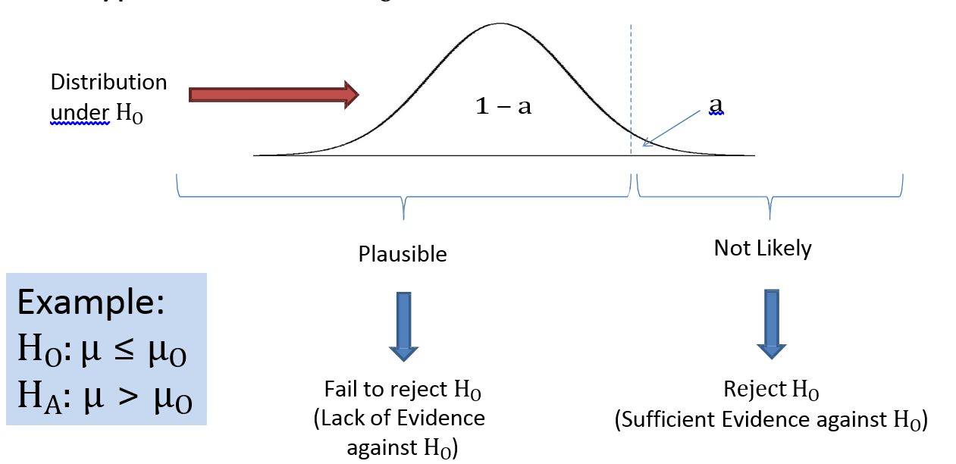
What are the chances of a Type I error?

Slide 30
What are the chances of a Type II error?

Slide 31
Picking the Null Hypothesis
Sometimes it is not clear what the null hypothesis should be.
You should always pick the null hypothesis such that the Type I Error is the worse of the two possible errors.
You do this because by changing α, you can control the probability of a Type I Error occurring.

Slide 32

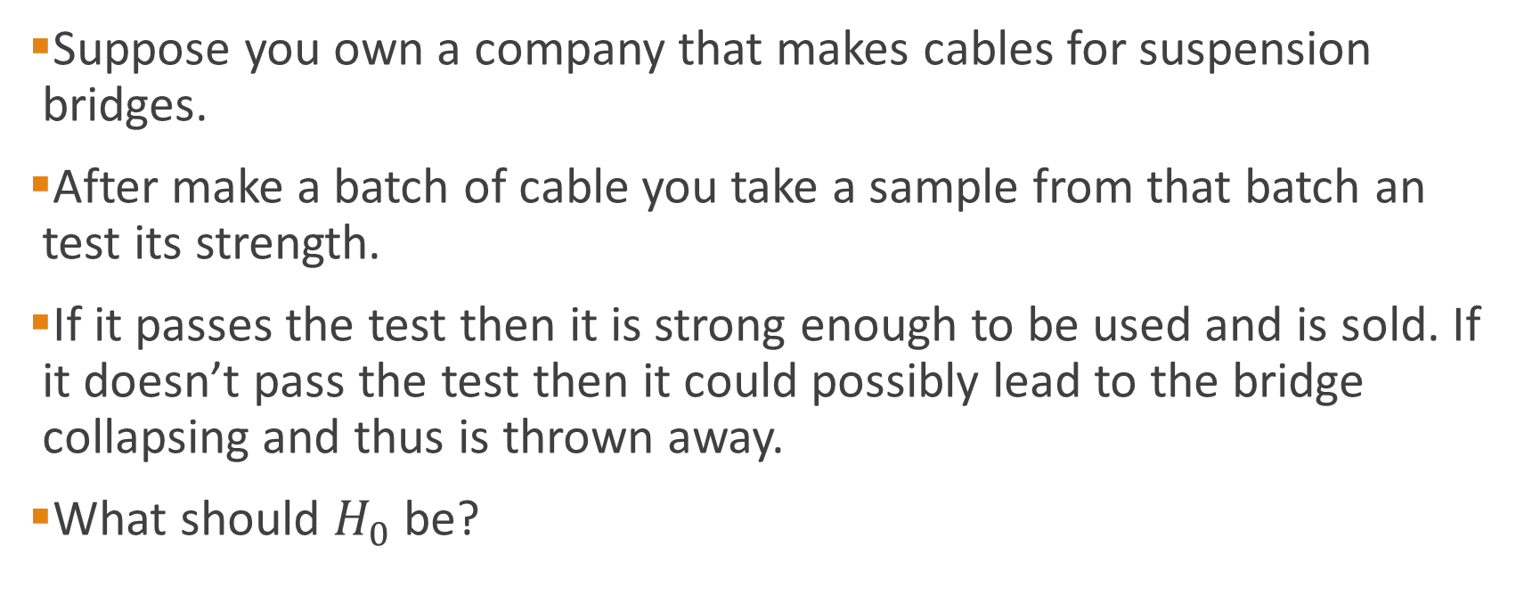
Example: Bridge Cable
Suppose you own a company that makes cables for suspension bridges.
After make a batch of cable you take a sample from that batch an test its strength.
If it passes the test then it is strong enough to be used and is sold. If it doesn’t pass the test then it could possibly lead to the bridge collapsing and thus is thrown away.
What should $H_{0}$ be?

Slide 33
Example: Bridge Cable
The two possible errors are
Selling defective cable.
Throwing away flawless cable.
If you really don’t want to kill people then you should set the null hypothesis to the cable being defective.
The Type I error in that case is saying the cable is okay when it really isn’t. By setting a to be very small, you can make the chances of cause a bridge failure small.
In other words, because you care about human life you will assume the cable is defective until there is sufficient evidence to convince you otherwise.

Slide 34
Confidence Intervals

Slide 35
How good is an estimate?
Remember that some statistics are designed to estimate a population parameter or value.
Sample mean or x- estimates the true population average, µx.
The sample standard deviation or sx estimates the true population standard deviation, σx .
We might want to ask how good are these estimators. In other words, how precise is the estimate?

Slide 36
Confidence Intervals
A confidence interval is a range of values where we think the true value is located with some level of confidence.
The confidence level is set by the researcher. The most common level is 95%.
The level of significance (α) is 100% minus the confidence level.
So if the level of significance is 5% then the confidence level is 95%.
α: level of significance
(1-α): confidence level

Slide 37
Margin of Error
The margin of error represents how much inaccuracy is included in the estimate because it is based upon a random sample.
The larger the margin of error, the less confident we are in the estimate.
The confidence interval is equal to the estimate plus or minus the margin of error:
Confidence Interval = Estimate ± Margin of Error

Slide 38
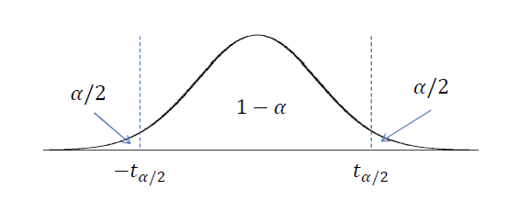
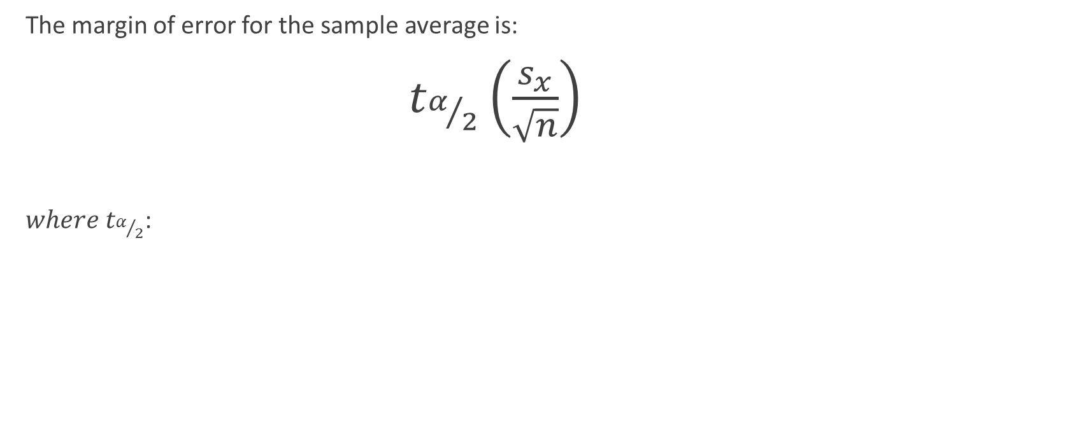
Confidence Intervals for Averages
The margin of error for the sample average is:
$t_{α/2}\left(\frac{s_{x}}{\sqrt{n}}\right)$
$where t_{α/2}$:

Slide 39
Example: Average Income Tacoma
Suppose that you wanted to estimate the average income of residents in Tacoma. You collect a random sample of 100 people. Your estimate is $40,000 with a sample standard deviation of $30,000.
Construct a confidence interval for the estimate of the true average income of Tacoma residents.

Slide 40
Example: Average Income Tacoma
From the question:
n =
100
sx =
$30,000
How do we find tα/2?
First, unless you are told differently , assume α = 5%.
The degrees of freedom is the sample size minus one,
n − 1 = 100 − 1 = 99

Slide 41
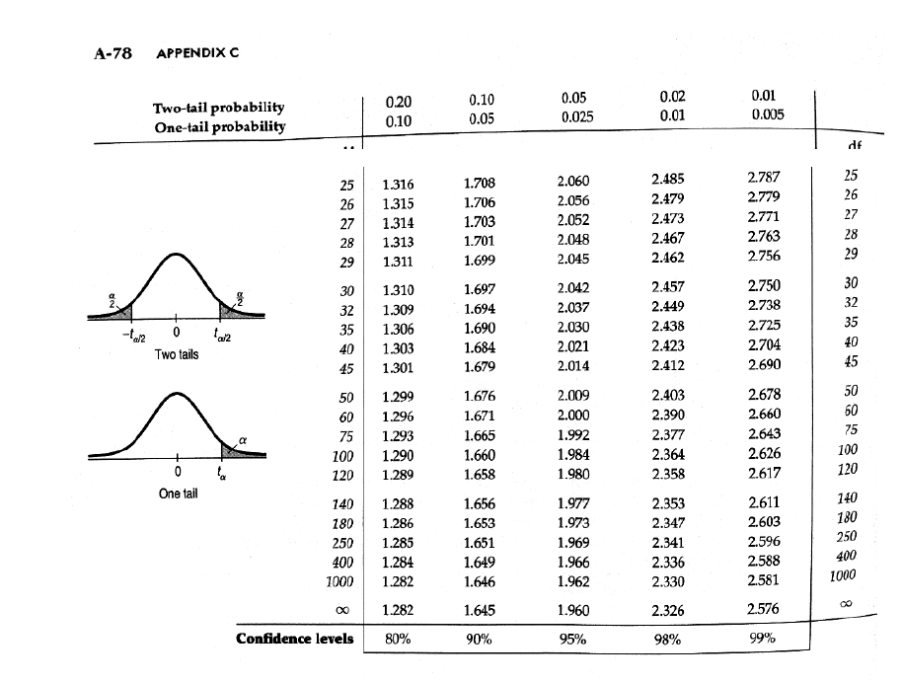

Slide 45
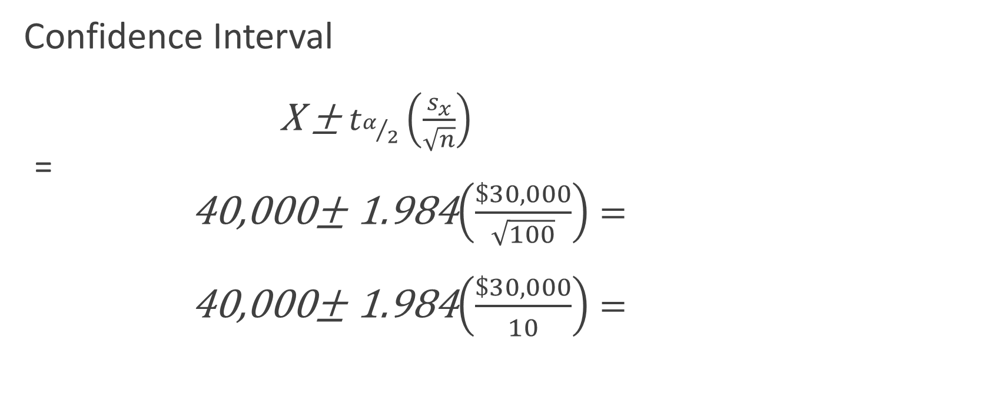
Example: Tacoma Average Income
Confidence Interval
X ± $t_{α/2}\left(\frac{s_{x}}{\sqrt{n}}\right)$
=
40,000± 1.984$\left(\frac{\$30,000}{\sqrt{100}}\right)=$
40,000± 1.984$\left(\frac{\$30,000}{10}\right)=$

Slide 46
Example: Tacoma Average Income
= $40,000 ± 1.984 * $3,000
= $40,000 ± $5,952
$34,048 to $45,952

Slide 47
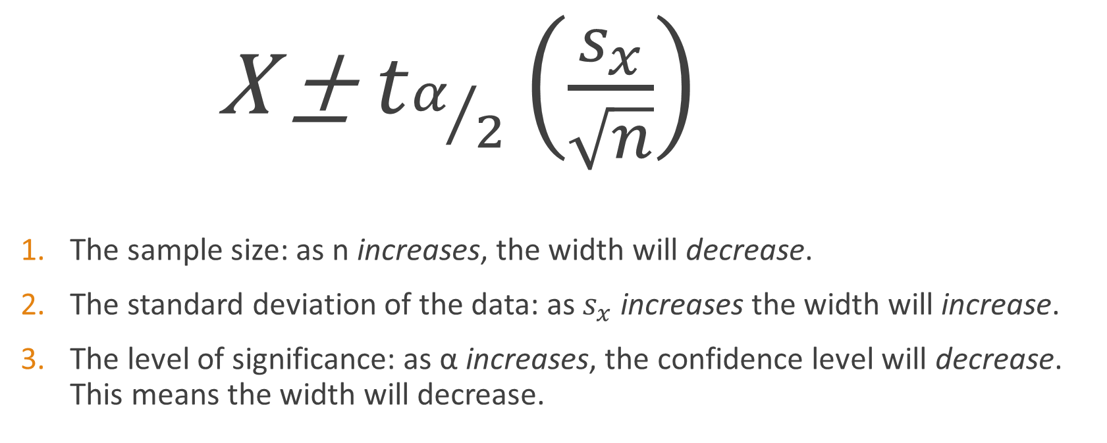
What affects the width of the confidence interval?
X ± $t_{α/2}\left(\frac{s_{x}}{\sqrt{n}}\right)$
The sample size: as n increases, the width will decrease.
The standard deviation of the data: as $s_{x}$ increases the width will increase.
The level of significance: as α increases, the confidence level will decrease. This means the width will decrease.

